Slide 1
DS4ALL: Teaching High-School Students Data Science and AI/ML Using the Texera Workflow Platform as a Service
A joint work of UC Irvine and UCLA
Presenter: Jiadong Bai, jiadongb@uci.edu

Slide 2
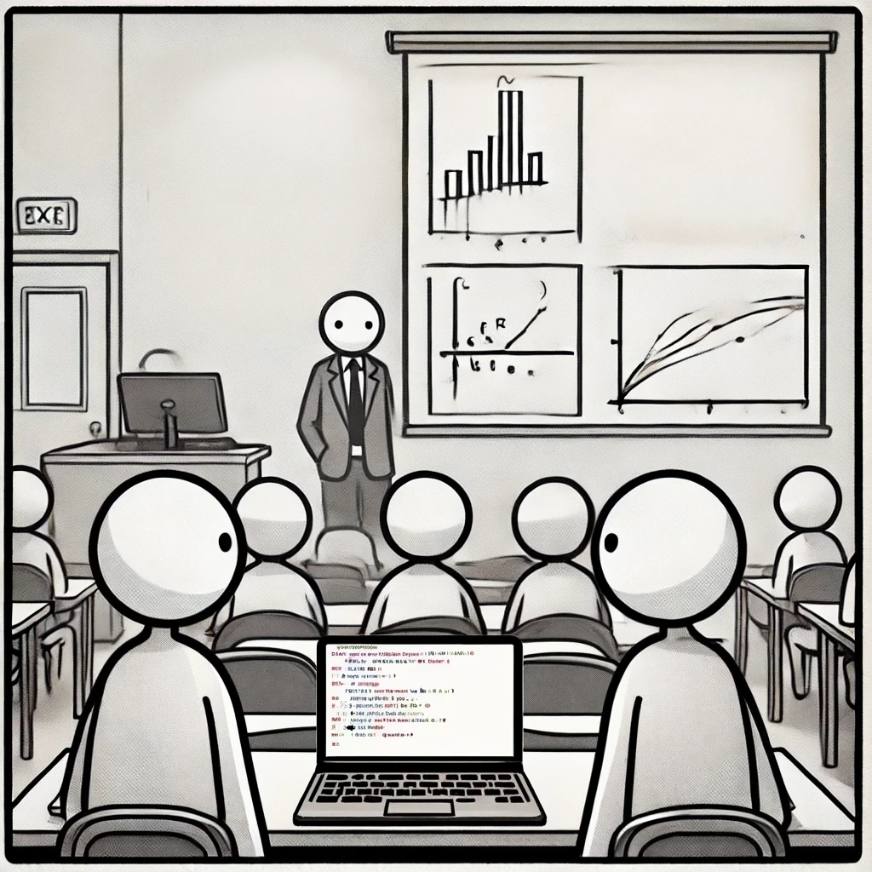
Common Data Science Teaching Paradigm
Coding required
Data
Visualization
Software installation required
Limited collaboration capability
Slow feedback loop
How can we improve this?

Slide 3
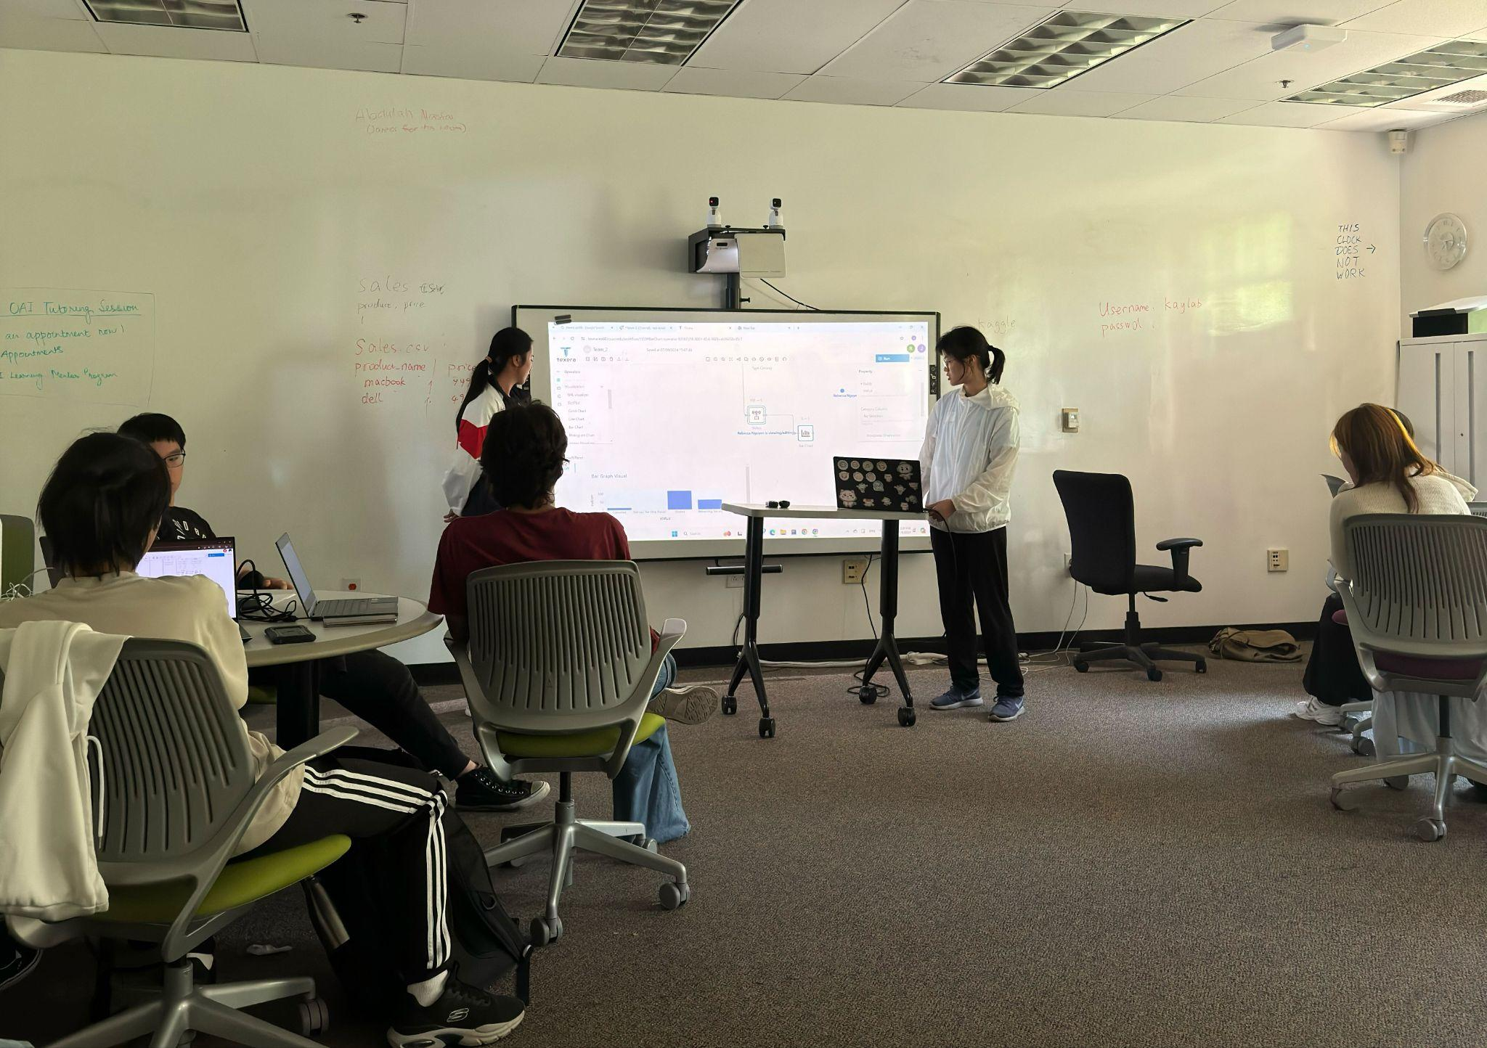
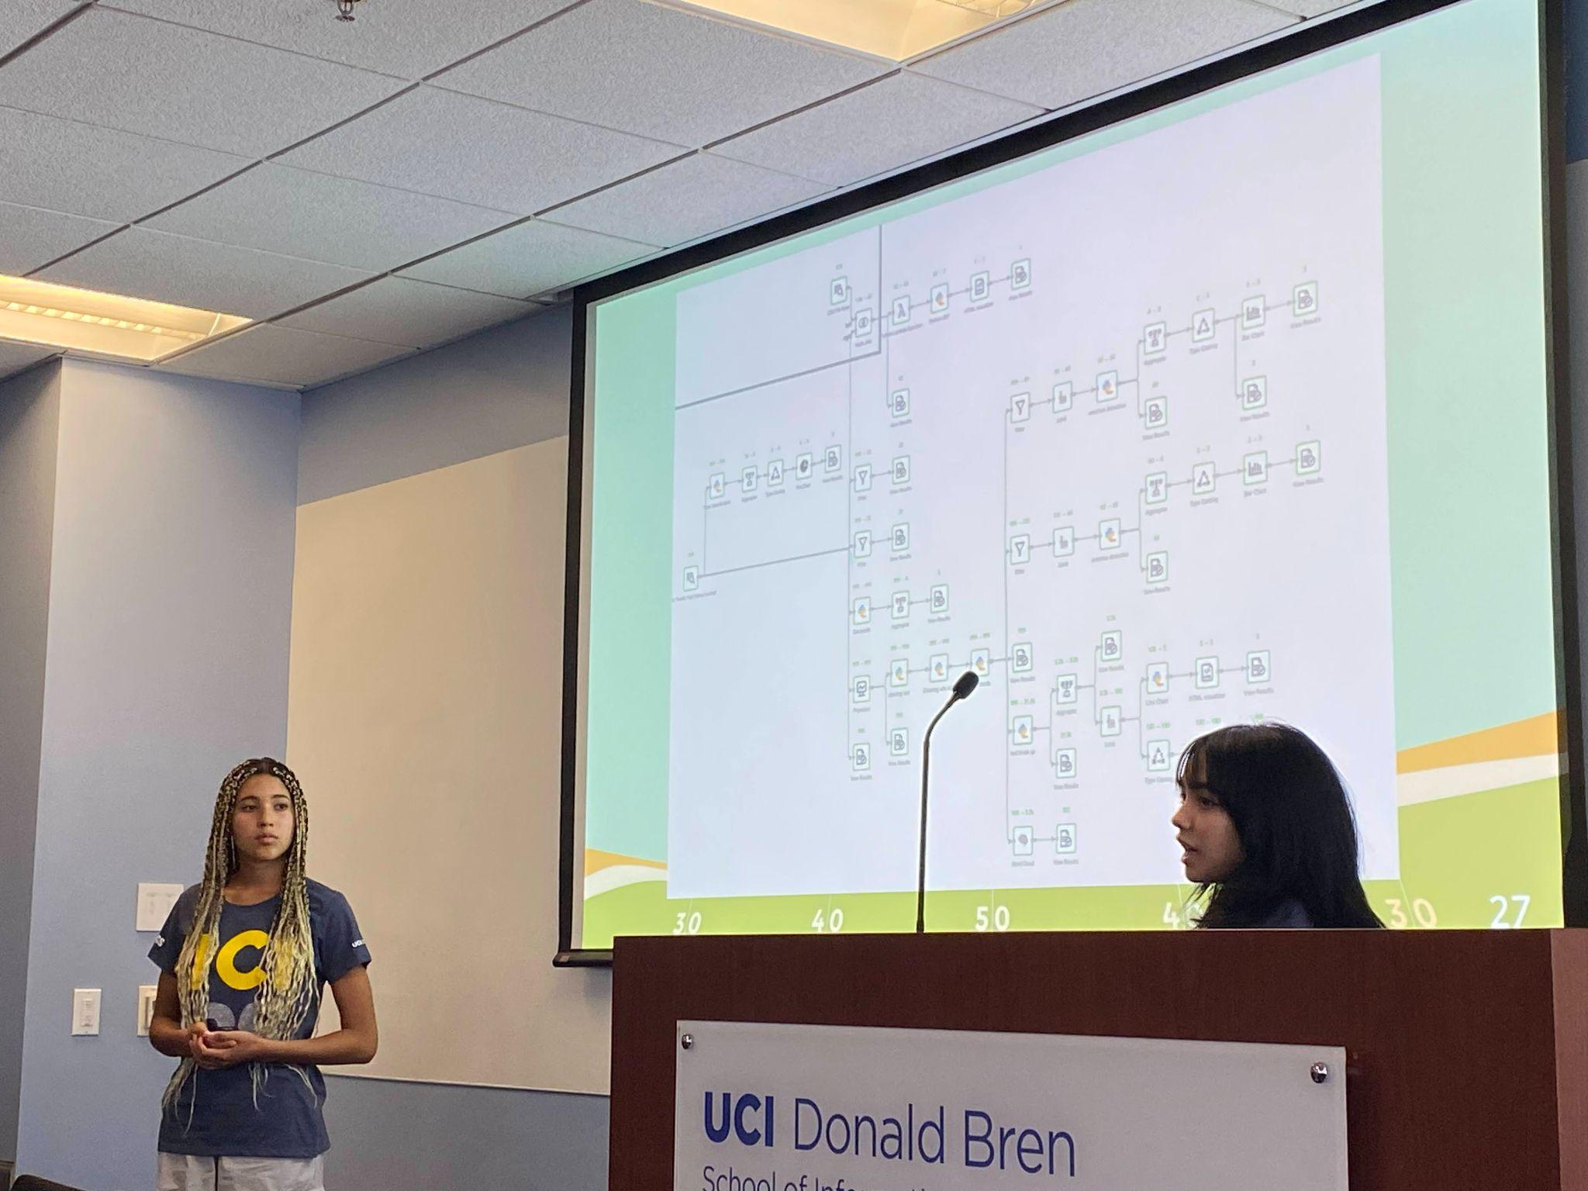
Our Exploration: “Data Science For ALL” Program
Summer 2023 and 2024
A free program funded by the NSF
A joint teaching effort of UCI and UCLA
Using Texera, a no/low-code cloud service

Slide 4
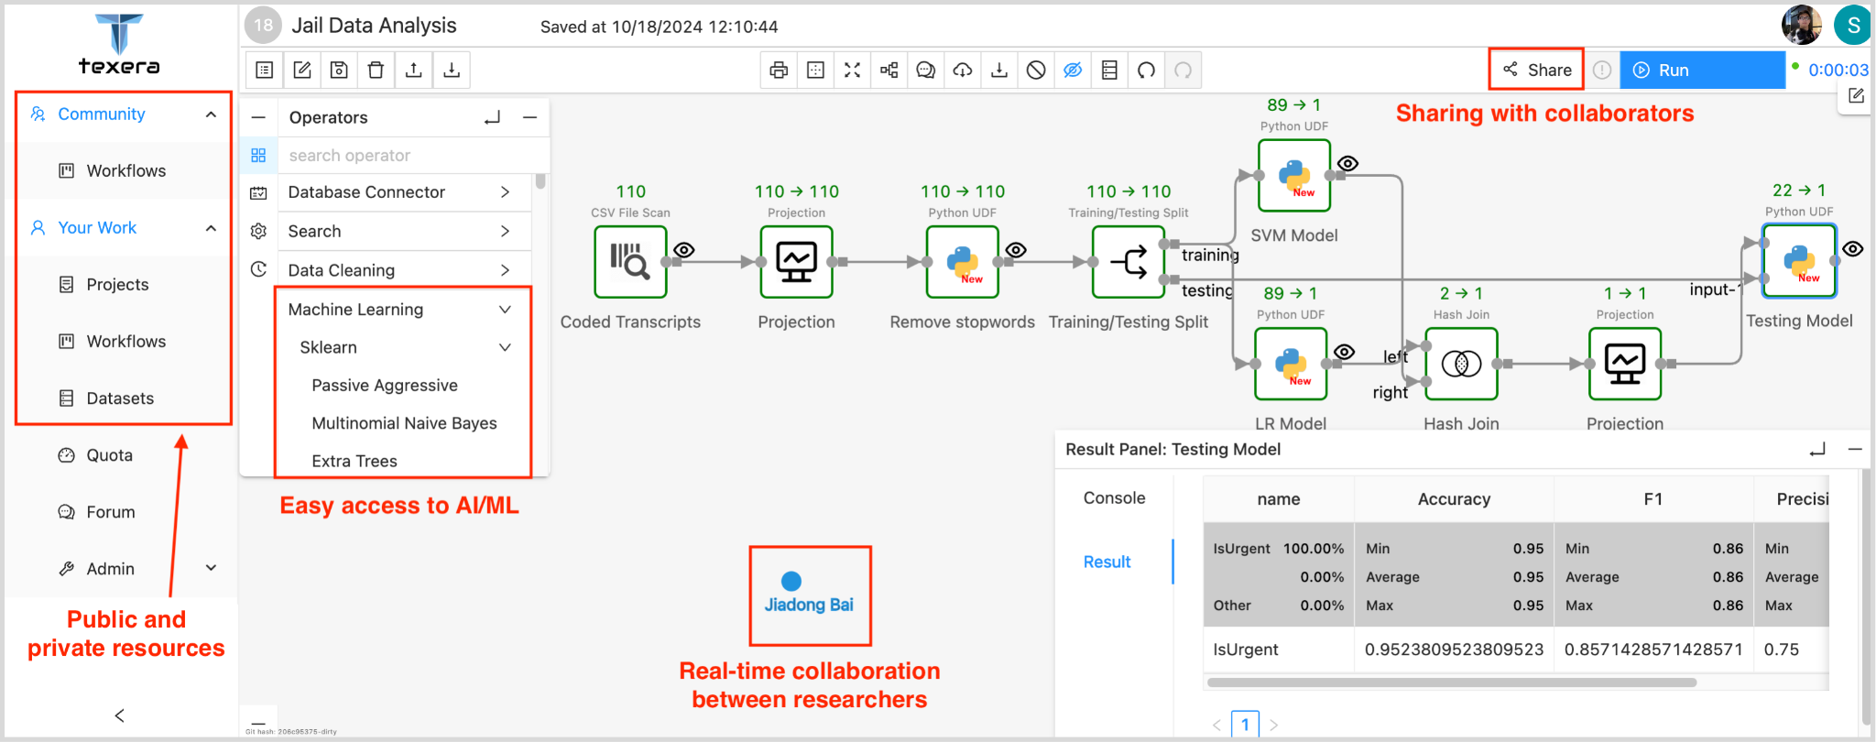
Texera: A Cloud Platform for Collaborative Data
Science and AI/ML
GUI-based Workflow
Cloud Service
Collaboration
AI/ML Access

Slide 5
Teach Data Science with Texera
Example: visualize the posting trend of tweets
create_at_month | #tweets
2018-11 | 103
2018-12 | 163
2019-01 | 97
2019-02 | 129
… | …
Data source: tweets_publish_trend.csv

Slide 6
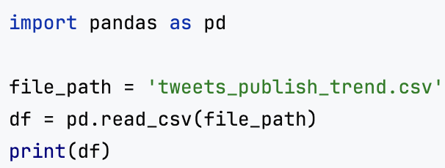
Learn Data Science with Texera
Step1: read the data source
via code (Python)
via Texera

Slide 7
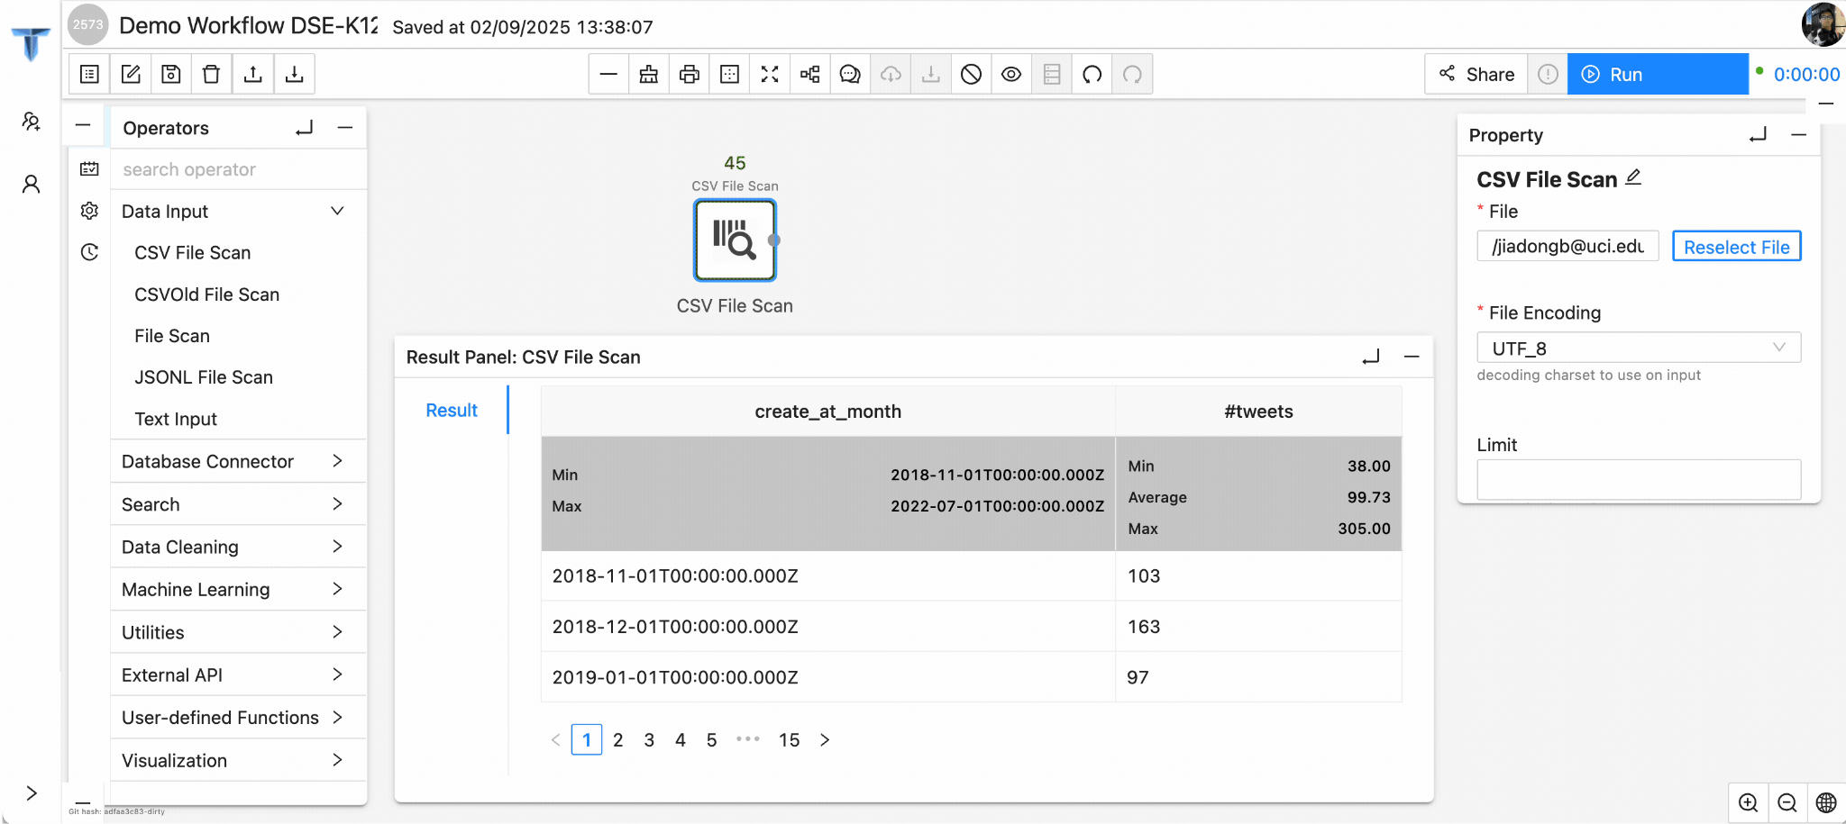
Learn Data Science with Texera
Step1: read the data source
via code (Python)
via Texera

Slide 8
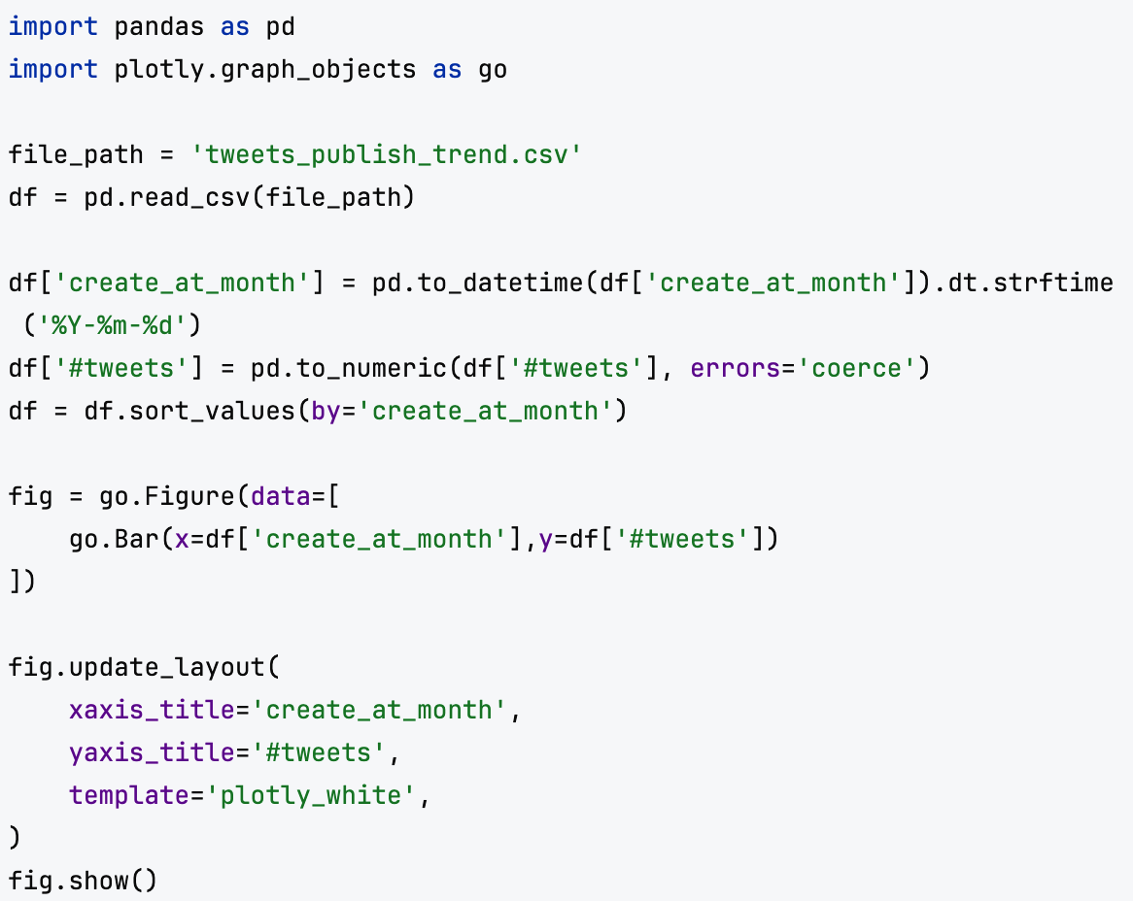
Step2: add a Bar Chart
via code (Python)
via Texera

Slide 9
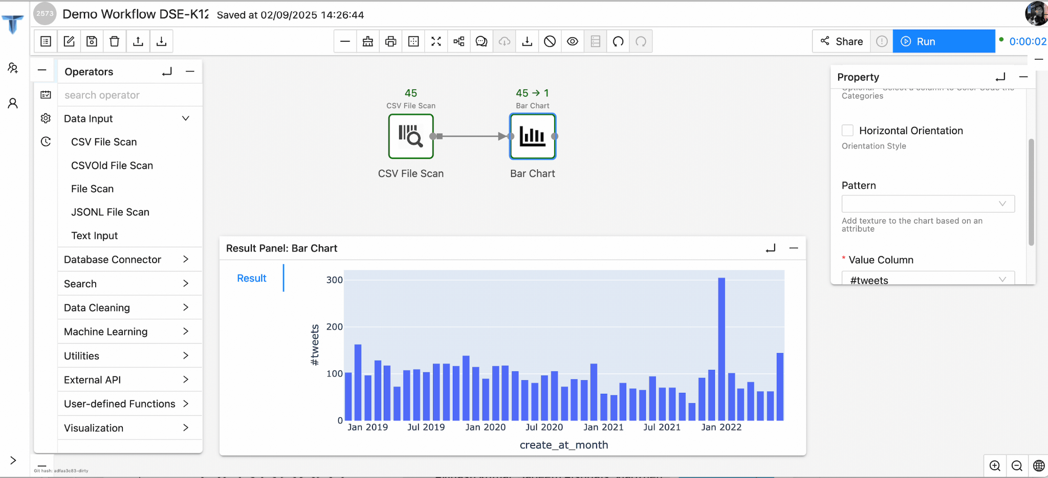
Step2: add a Bar Chart
via code (Python)
via Texera

Slide 10
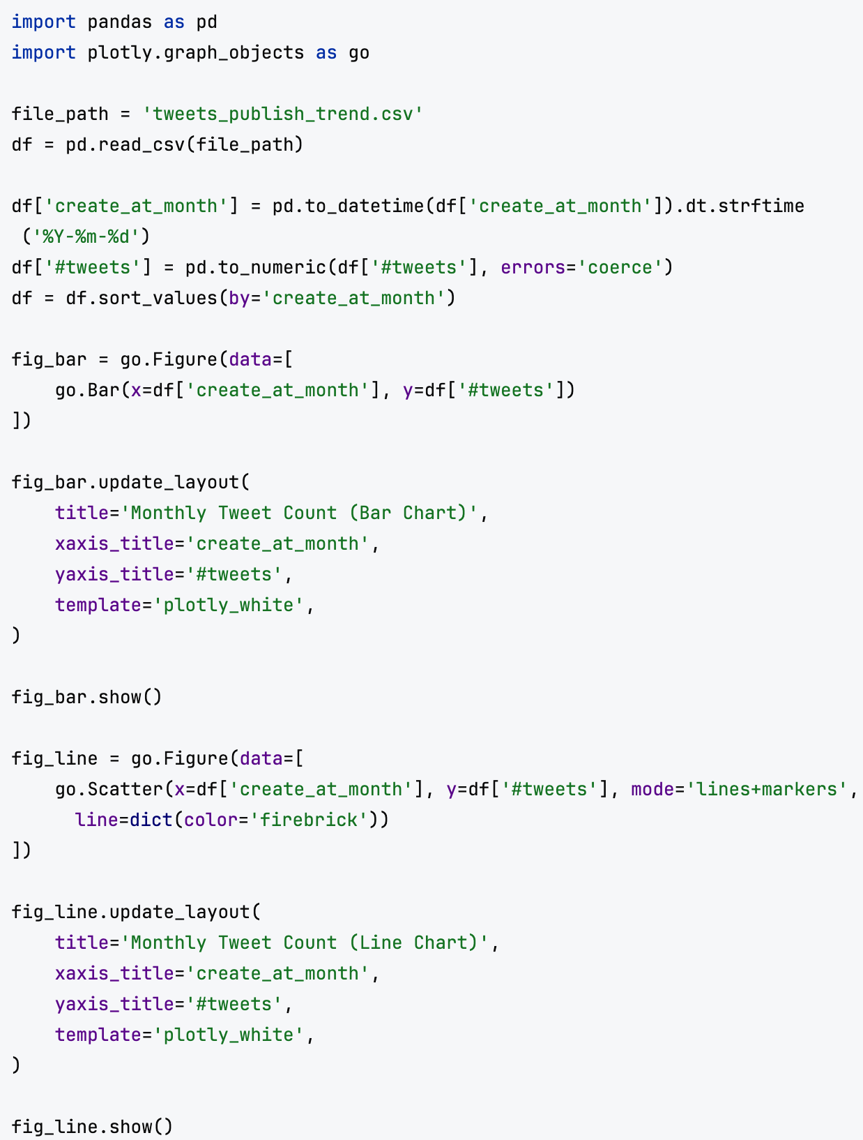
Step3: add a Line Chart
via code (Python)
via Texera

Slide 11
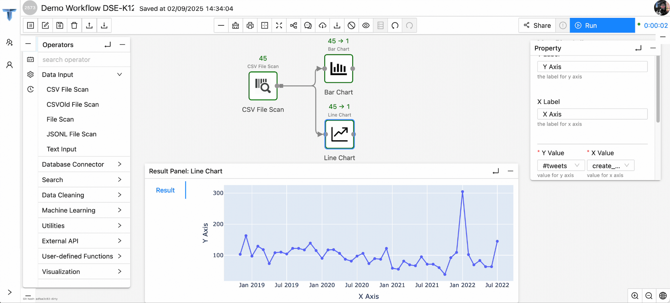
Step3: add a Line Chart
via code (Python)
via Texera

Slide 12
Collaborate with other students
Workflow access control panel
Two students collaborate on the same workflow

Slide 13
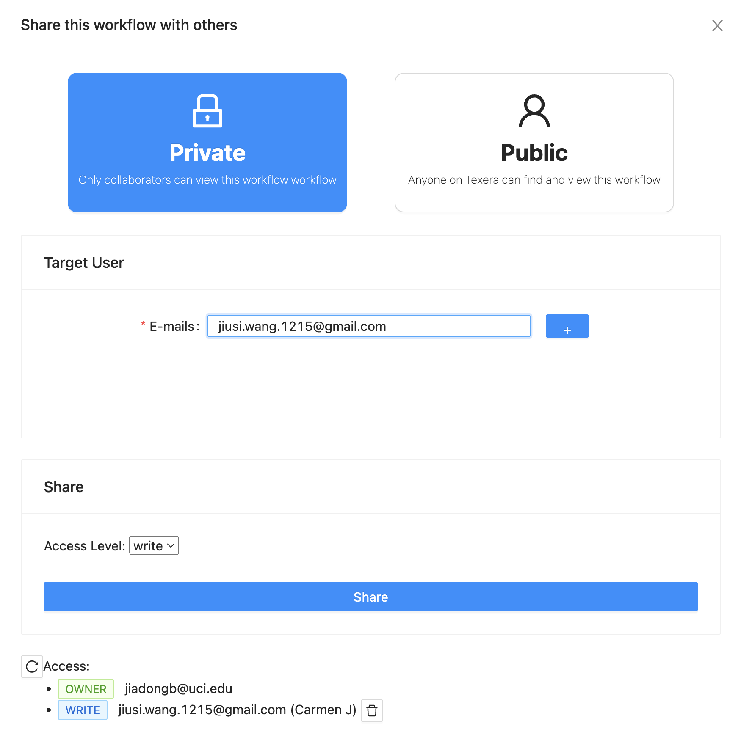
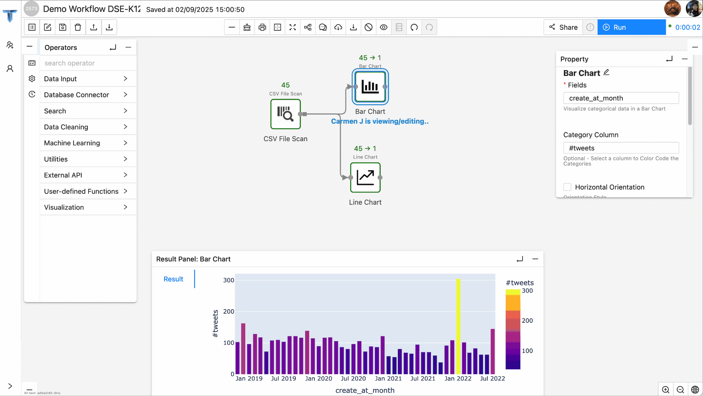
Collaborate with other students
Workflow access control panel
Two students collaborate on the same workflow

Slide 14
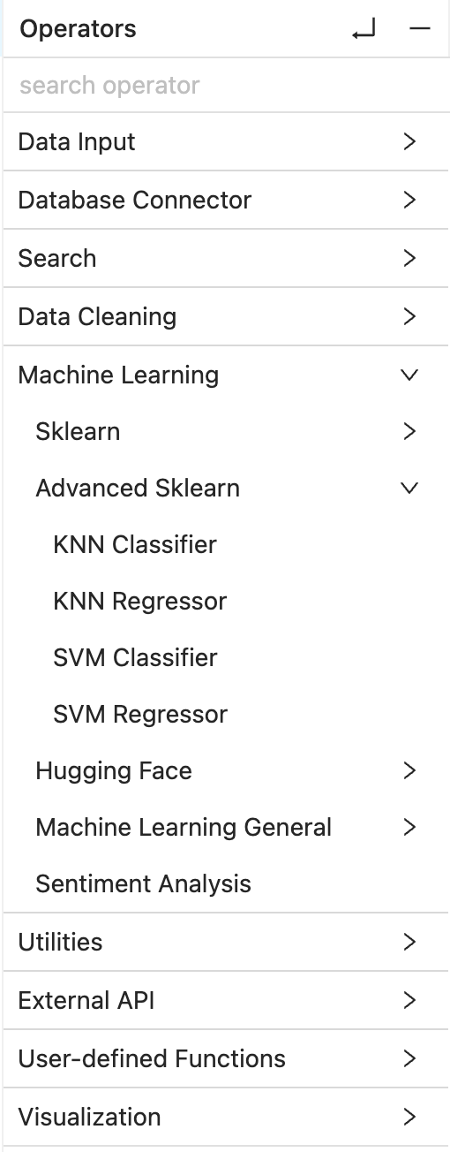
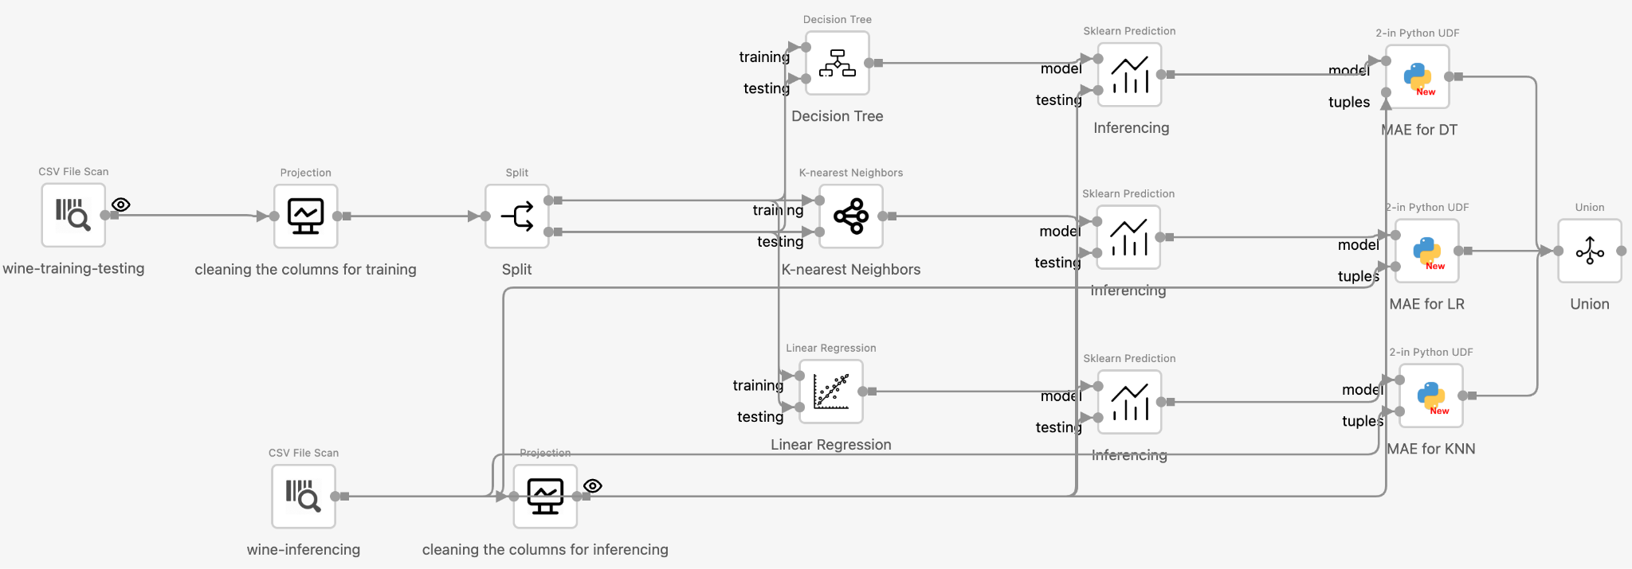
Learn AI/ML
A workflow that compares 3 ML Models on the same dataset
Available operators on Texera

Slide 15
2024 program schedule
Week 1: Basic Data Science Operations & Python
Date | Morning (Lecture) | Afternoon (Lab)
July 8, 2024 | Program Overview; Texera Platform Overview; Construct the 1st Data Analytics Workflow on Texera | Form teams; Project topic discussion
July 9, 2024 | Data and data wrangling concepts; Data science operators - Scan, Projection, Type Cast, Sort, Filter | Collaborative project development in each team; Project progress demo by each team;
July 10, 2024 | Data science operators - Union, Distinct, Intersection, Diff, Aggregate, Join; Python basics; Python UDF tuple API basics
July 11, 2024 | Python intermediate; Python UDF tuple API exercise; Python UDF table API basics
July 12, 2024 | Python advance; Python UDF table API exercise; Machine Learning introduction and hands-on practice using ML operators

Slide 16
2024 program schedule
Week 2: AI/ML
Date | Morning (Lecture) | Afternoon (Lab)
July 15, 2024 | Introduction to AI; Classification | Collaborative project development in each team; Project progress demo by each team;
July 16, 2024 | Machine Learning Foundations; Linear Regression
July 17, 2024 | Neural Networks
July 18, 2024 | Computer Vision, Probability, Natural Language Processing
July 19, 2024 | ChatGPT: learn how to play around with it | Project Showcase

Slide 17
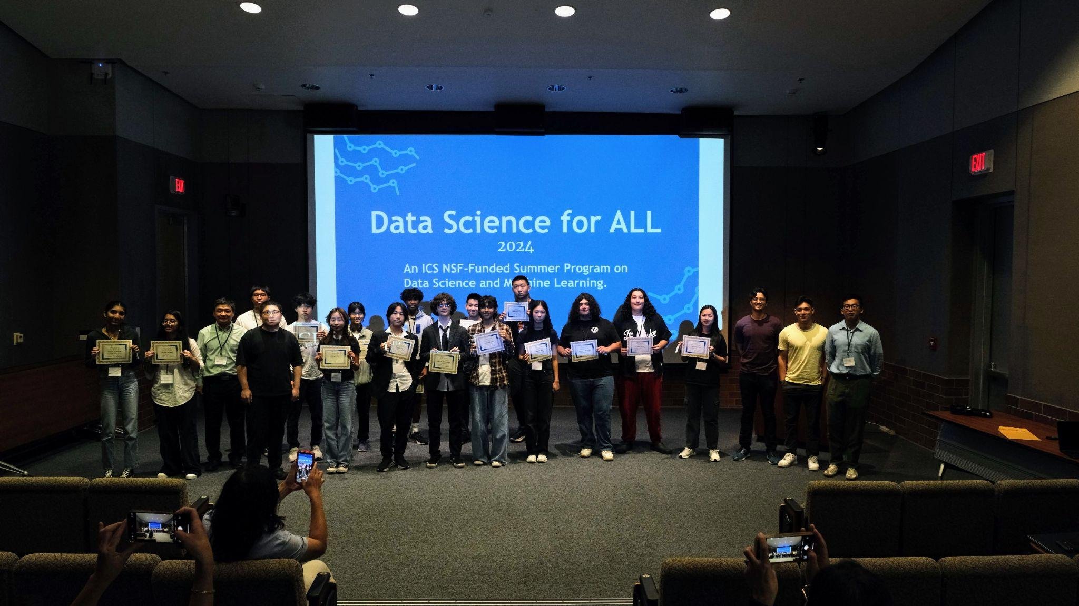
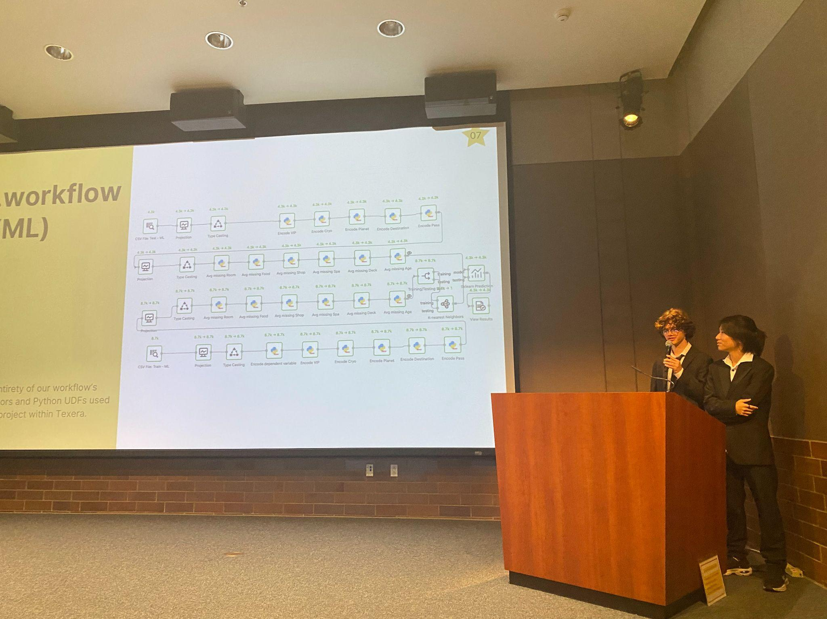
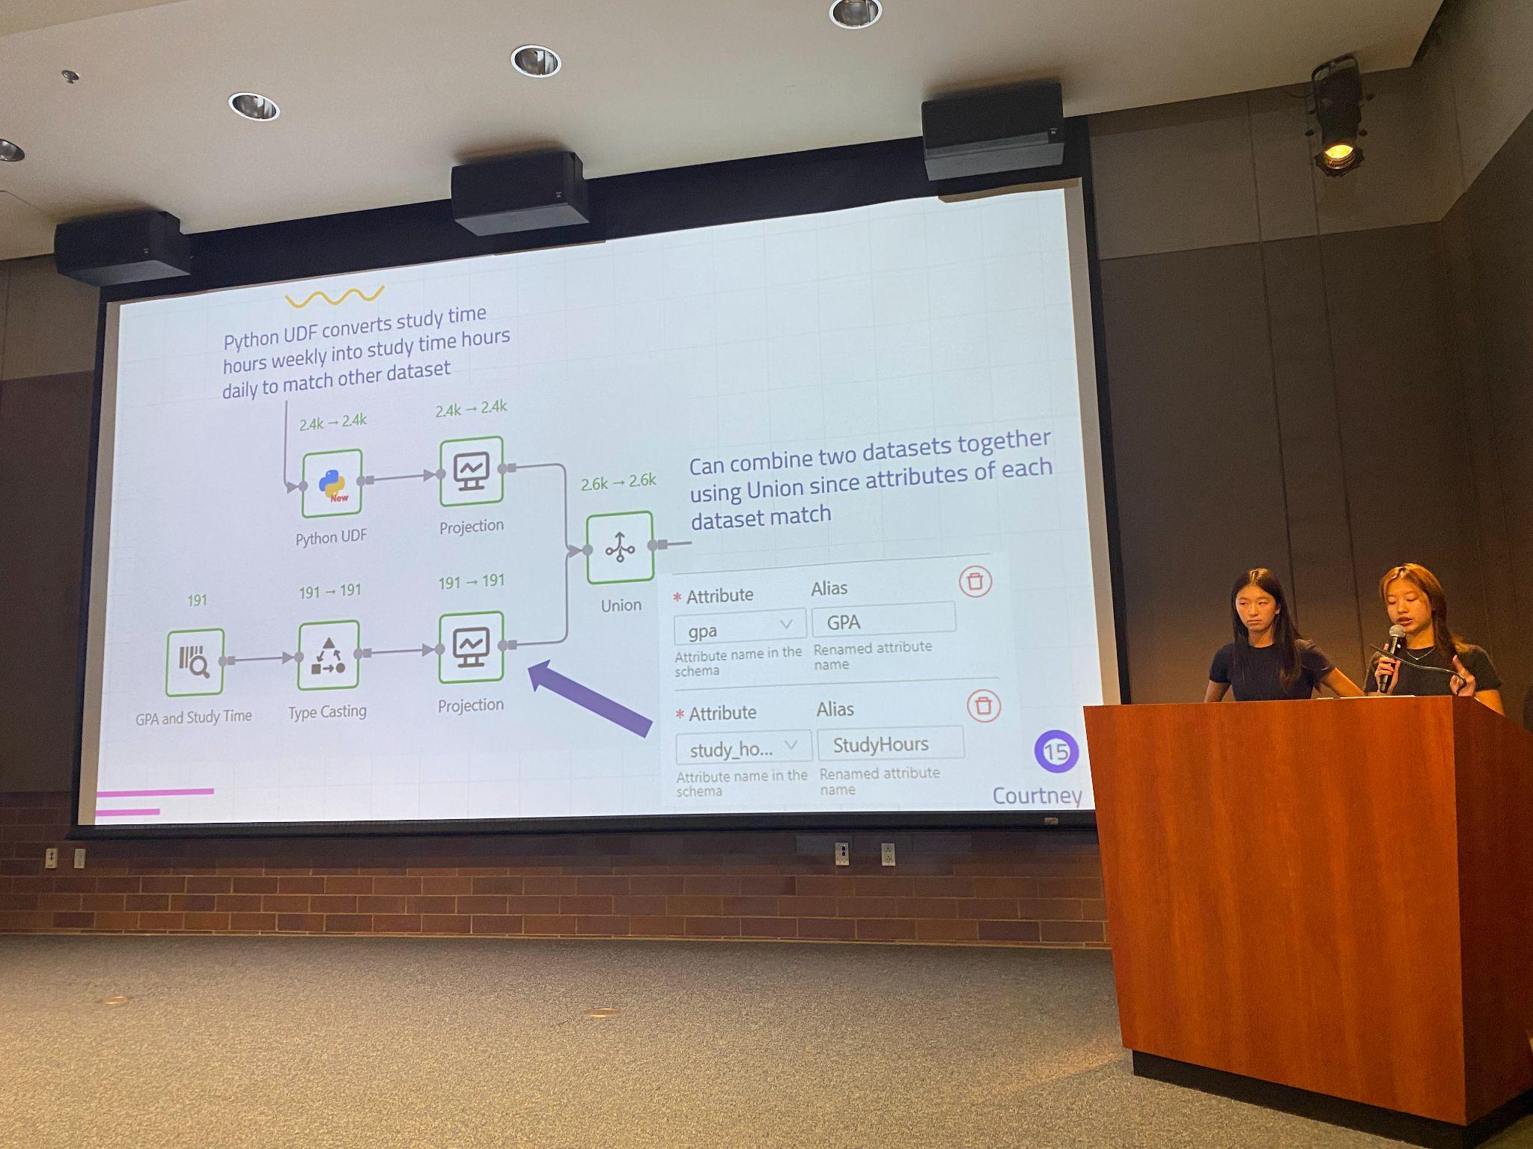
Results of 2024 program
16 students
132 workflows created, in which:
21% used ML models
64% used custom Python operators
8 capstone projects, 100% used Python and ML models
Two groups were presenting their capstone projects

Slide 18
Summary: our teaching paradigm with Texera
No prior coding experience required
No software installation
Seamless collaboration experience
Efficient feedback loop

Slide 19
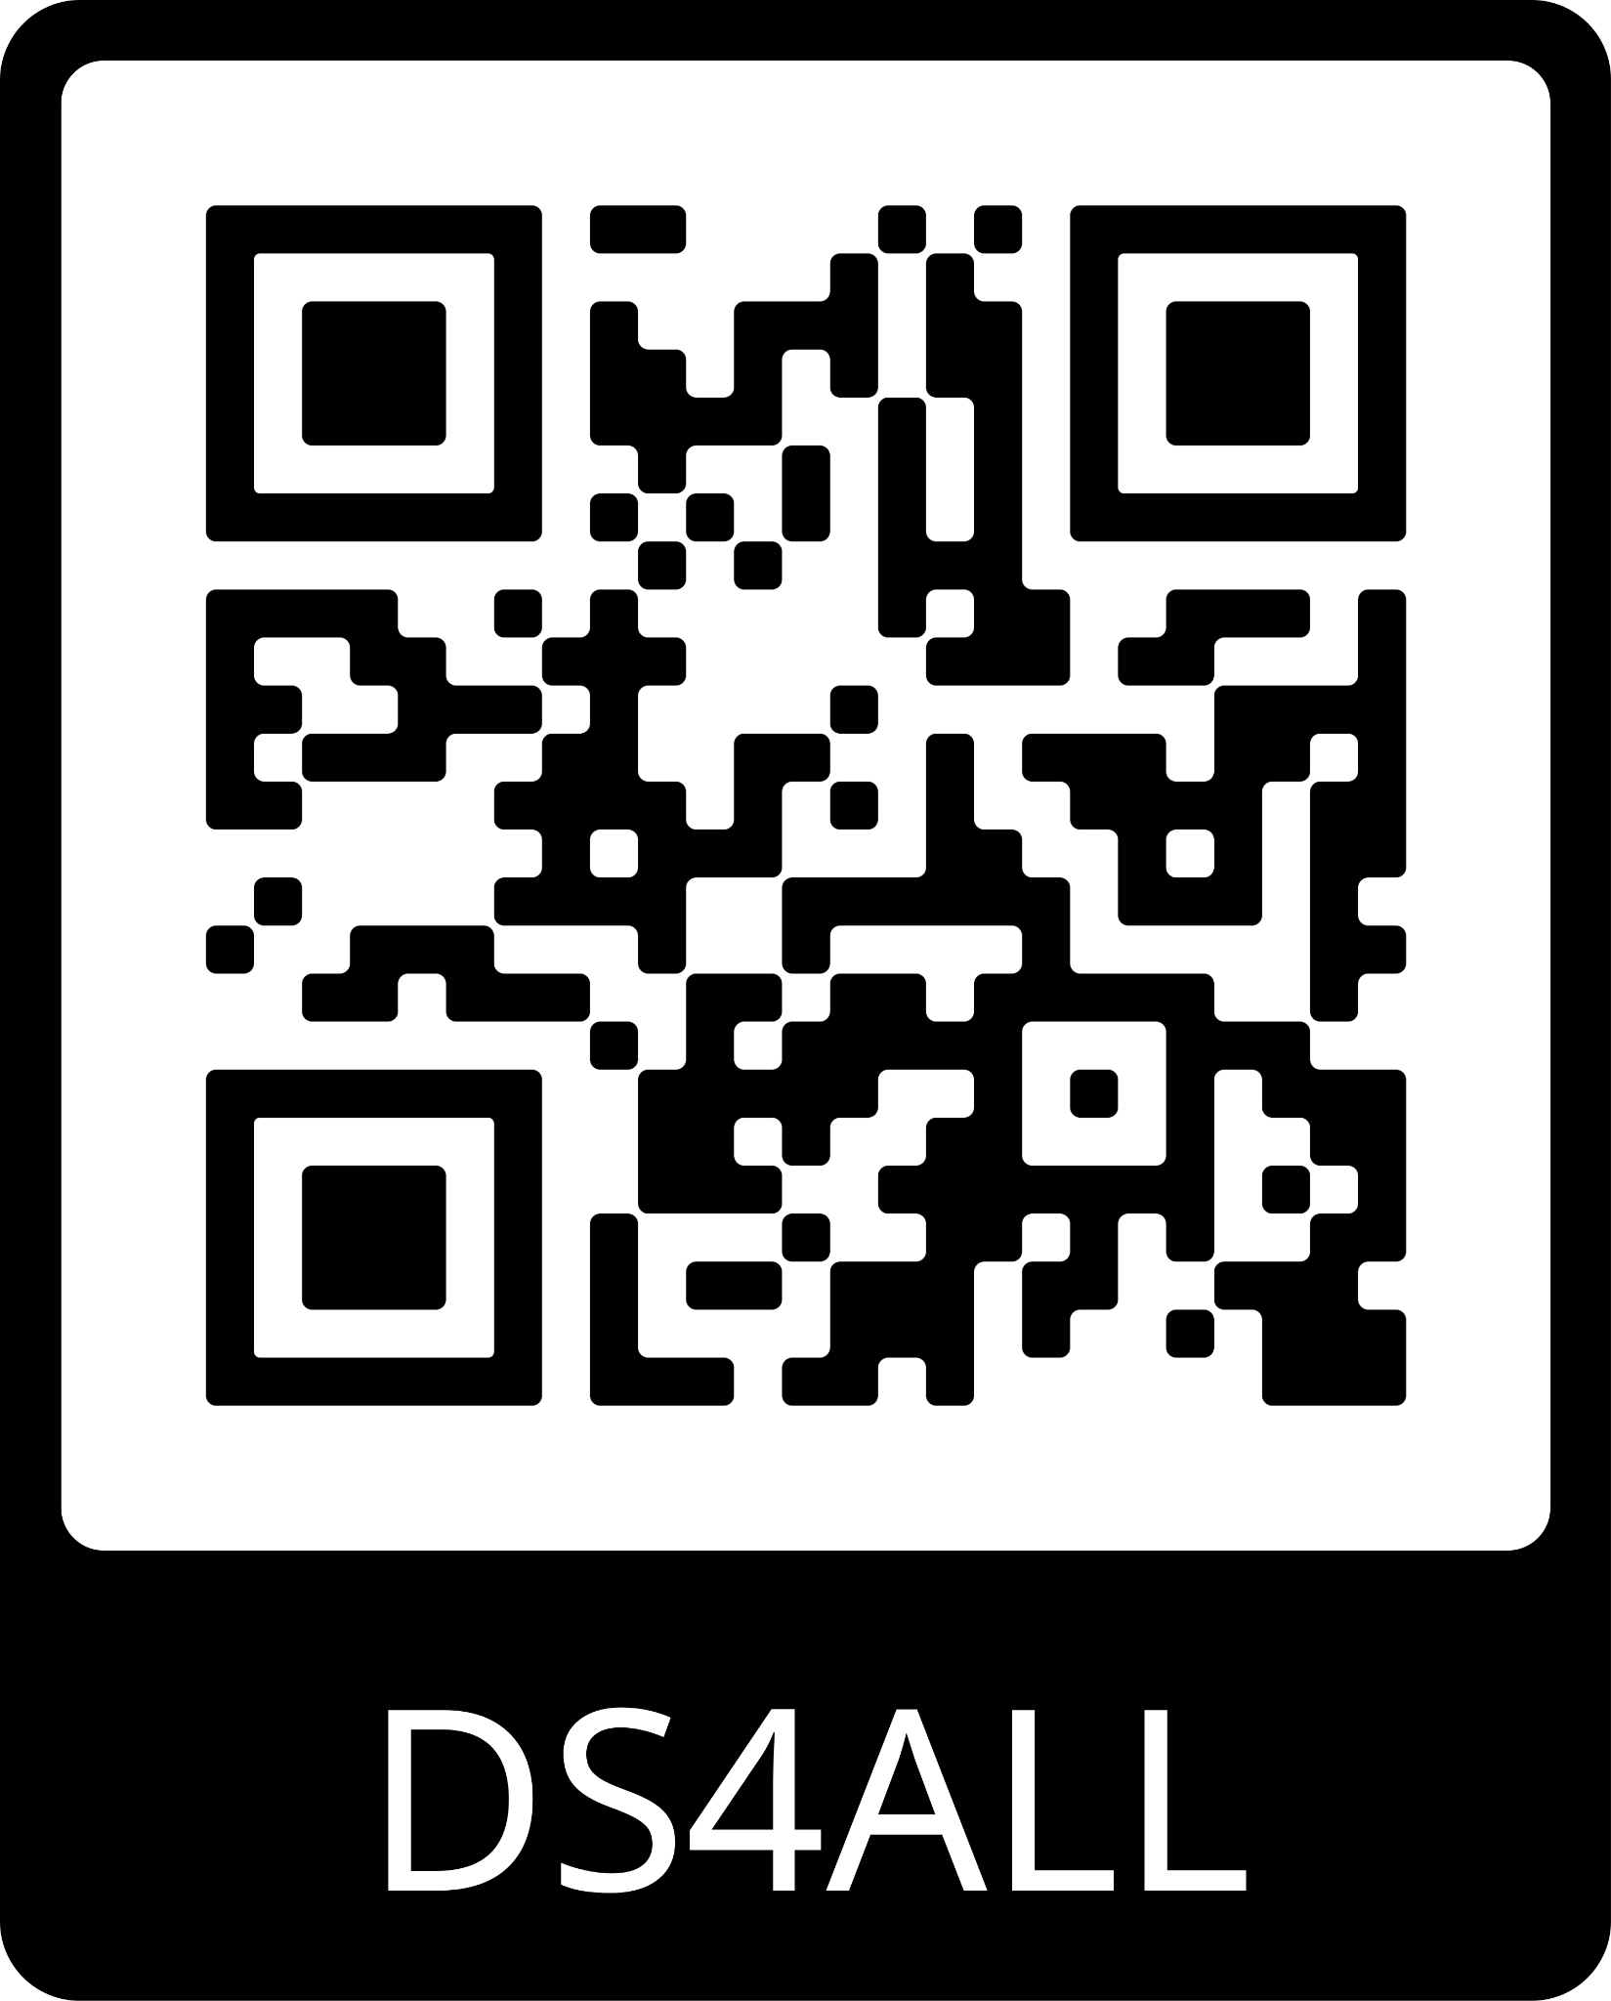
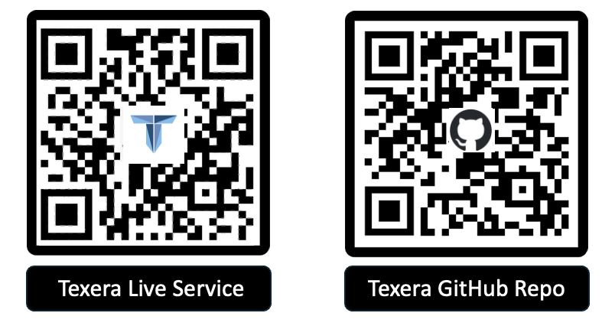
Thank you for listening!
Learn more about DS4ALL: https://ds4all.ics.uci.edu/
Learn more about Texera:
https://texera.io/
Notes:
If you want to see a demo, feel free to talk to me or email to jiadongb@uci.edu

